Slide 1
Concurrency Control Technique

Slide 2
Concurrency Control
Concurrency control is the procedure in DBMS for managing simultaneous operations without conflicting with each another.
Concurrency control is used to address such conflicts which mostly occur with a multi-user system. It helps you to make sure that database transactions are performed concurrently without violating the data integrity of respective databases.

Slide 3
Assume that two people who go to electronic kiosks at the same time to buy a movie ticket for the same movie and the same show time.
However, there is only one seat left in for the movie show in that particular theatre. Without concurrency control, it is possible that both moviegoers will end up purchasing a ticket. However, concurrency control method does not allow this to happen. Both moviegoers can still access information written in the movie seating database. But concurrency control only provides a ticket to the buyer who has completed the transaction process first.

Slide 4
Concurrency Control Protocols
Different concurrency control protocols offer different benefits between the amount of concurrency they allow and the amount of overhead that they impose.
Lock-Based Protocols
Timestamp-Based Protocols
Validation-Based Protocols

Slide 5
Lock-based Protocols
LOCK
A lock is a data variable which is associated with a data item. This lock signifies that operations that can be performed on the data item. Locks help synchronize access to the database items by concurrent transactions.
All lock requests are made to the concurrency-control manager. Transactions proceed only once the lock request is granted.

Slide 6
1. Shared Lock (S):
A shared lock is also called a Read-only lock. With the shared lock, the data item can be shared between transactions. This is because you will never have permission to update data on the data item.
For example, consider a case where two transactions are reading the account balance of a person. The database will let them read by placing a shared lock. However, if another transaction wants to update that account's balance, shared lock prevent it until the reading process is over.

Slide 7
2. Exclusive Lock (X):
With the Exclusive Lock, a data item can be read as well as written. This is exclusive and can't be held concurrently on the same data item. X-lock is requested using lock-x instruction. Transactions may unlock the data item after finishing the 'write' operation.
For example, when a transaction needs to update the account balance of a person. You can allows this transaction by placing X lock on it. Therefore, when the second transaction wants to read or write, exclusive lock prevent this operation.

Slide 8
Two Phase Locking (2PL) Protocol
The Two-Phase Locking protocol allows each transaction to make a lock or unlock request in two steps:
Growing Phase: In this phase transaction may obtain locks but may not release any locks.
Shrinking Phase: In this phase, a transaction may release locks but not obtain any new lock
It is true that the 2PL protocol offers serializability. However, it does not ensure that deadlocks do not happen.

Slide 9
Types of 2PL
Basic 2PL
Conservative 2PL
Strict 2PL
Rigorous 2PL

Slide 10
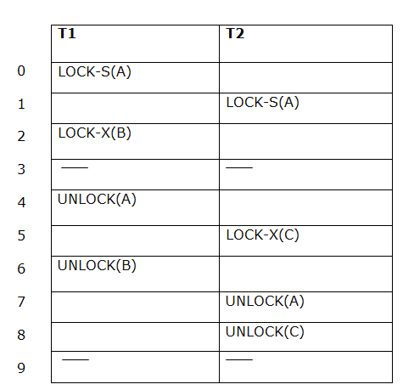
Basic 2PL
The following way shows how unlocking and locking work with 2-PL.
Transaction T1:
Growing phase: from step 1-3
Shrinking phase: from step 5-7
Lock point: at 3
Transaction T2:
Growing phase: from step 2-6
Shrinking phase: from step 8-9
Lock point: at 6

Slide 11
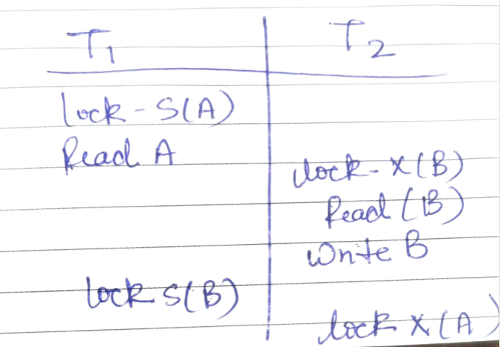
1. Ensure conflict and view serializabilty
2. Does not ensure freedom from deadlock

Slide 12
Dealing with Deadlock and Starvation
Deadlock
T’1 T’2
read_lock (Y); T1 and T2 did follow two-phase
read_item (Y); policy but they are deadlock
read_lock (X);
read_item (Y);
write_lock (X);
(waits for X) write_lock (Y);
(waits for Y)
Deadlock (T’1 and T’2)

Slide 13
Conservative / Static 2PL
Static 2-PL, this protocol requires the transaction to lock all the items it access before the Transaction begins execution by predeclaring its read-set and write-set. If any of the predeclared items needed cannot be locked, the transaction does not lock any of the items, instead, it waits until all the items are available for locking. So the operation on data cannot start until we lock all the items required.
Independent from deadlock
May have irrecoverability and cascading rollback

Slide 14
 | T₁ | T₂
1 | Lock-X(A)
2 | Lock-X(B)
3 | Read(A)
4 | *operation on A
5 | Write(A)
6 | Unlock(A)
7 |  | Lock-X(A)
8 |  | Read(A)
9 |  | *operation on A
10 |  | Write(A)
11 |  | Unlock(A)
12 | Read(B)
13 | *operation on B
14 | Write(B)
15 | Unlock(B)
16 | Commit
17 |  | Commit

Slide 15
Rigourous 2PL
The two rules of Rigorous 2PL are:
If a transaction T wants to read/write an object, it must request a shared/exclusive lock on the object.
All locks (both exclusive and shared) held by transaction T are released when T commits (and not before).
Under rigorous 2PL, transactions can be serialized by the order in which they commit.

Slide 16
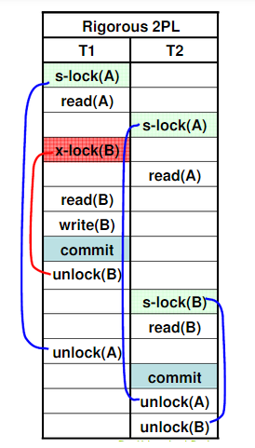

Slide 17
Strict 2PL
Here a transaction must hold all its exclusive locks till it commits/aborts.

Slide 18
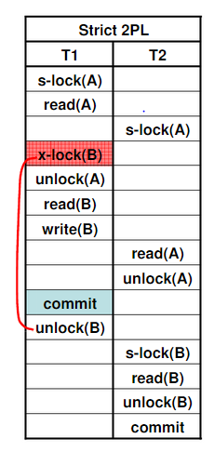

Slide 19
Timestamp Based Protocol
Timestamp Ordering Protocol –
The main idea for this protocol is to order the transactions based on their Timestamps.
Stating simply, the schedule is equivalent to the particular Serial Order corresponding to the order of the Transaction timestamps.

Slide 20
Timestamp
A monotonically increasing variable (integer) indicating the age of an operation or a transaction. A larger timestamp value indicates a more recent event or operation.
Timestamp based algorithm uses timestamp to serialize the execution of concurrent transactions.
Typically, timestamp values are assigned in the order in which the transactions are submitted to the system. So, a timestamp can be thought of as the transaction start time. Therefore, time stamping is a method of concurrency control in which each transaction is assigned a transaction timestamp →TS(Ti)

Slide 21
To ensure this, use two Timestamp Values relating to each database item X.
W­_TS(X) is the latest timestamp of any transaction that executed write(X) successfully.
R_TS(X) is the latest timestamp of any transaction that executed read(X) successfully.

Slide 22
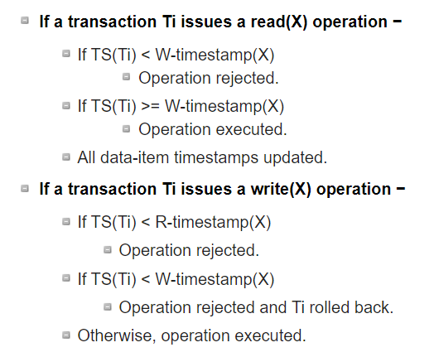

Slide 23
Properties of timestamp based protocol
1. ensure conflict serializabilty
2. ensure view serializability
3. possibility of dirty read
4. no chance of deadlock
5. may have starvation

Slide 24
Thomas' Write Rule
This rule states if TS(Ti) < W-timestamp(X), then the operation is rejected and T_{i} is rolled back.
Time-stamp ordering rules can be modified to make the schedule view serializable.
Instead of making T_{i} rolled back, the 'write' operation itself is ignored.
S.No | T1 | T2 | T3
1 | R(Q)
2 |  | W(Q)
3 | R(Q)
4 |  |  | W(Q)

Slide 25
Validation based protocol
Validation Based Protocol is also called Optimistic Concurrency Control Technique. This protocol is used in DBMS (Database Management System) for avoiding concurrency in transactions. It is called optimistic because of the assumption it makes, i.e. very less interference occurs therefore there is no need for checking while the transaction is executed.

Slide 26
In this technique, no checking is done while the transaction is been executed. Until the transaction end is reached updates in the transaction are not applied directly to the database.
All updates are applied to local copies of data items kept for transaction. At the end of transaction execution, while execution of transaction, a validation phase checks whether any of transaction updates violate serializability. If there is no violation of serializability the transaction is committed and the database is updated; or else, the transaction is rolled back and then restarted.

Slide 27
Optimistic Concurrency Control is a three-phase protocol. The three phases for validation-based protocol:
Read Phase: Values of committed data items from the database can be read by a transaction. Updates are only applied to local data versions.
Validation Phase: Checking is performed to make sure that there is no violation of serializability when the transaction updates are applied to database.
Write Phase: On the success of validation phase, the transaction updates are applied to the database, otherwise, the updates are discarded and the transaction is slowed down.

Slide 28
Validation Phase
3 Timestamp
Start T – Start of Execution of T
Validation T – Start of Validation Phase of T
Finish T – End of Write Phase of T

Slide 29
Validation Test
1. Write_set: of a transaction contains all the write operations that T_{i} performs.
2. Read_set: of a transaction contains all the read operations that T_{i} performs.
In the Validation phase for transaction T_{i} the protocol inspect that T_{i} doesn’t overlap or intervene with any other transactions currently in their validation phase or in committed. The validation phase for T_{i} checks that for all transaction T_{j} one of the following below conditions must hold to being validated or pass validation phase:

Slide 30
1. Finish(T_{j})<Starts(T_{i}), since T_{j} finishes its execution means completes its write-phase before T_{i} started its execution(read-phase). Then the serializability indeed maintained.
2. T_{i} begins its write phase after T_{j} completes its write phase, and the read_set of T_{i} should be disjoint with write_set of T_{j}.
3. T_{j} completes its read phase before T_{i} completes its read phase and both read_set and write_set of T_{i} are disjoint with the write_set of T_{j}.

Slide 31
T_{j} | T_{i}
r(x) // x=12
 | r(x)
 | x=x-10 r(y) //y=15
 | y=y+10 r(x)
<validate> print(x+y)
 | <validate>
 | w(x) w(y)

Slide 32
Multiple Granularity
Granularity: It is the size of data item allowed to lock.

Slide 33
Multiple Granularity:
It can be defined as hierarchically breaking up the database into blocks which can be locked.
The Multiple Granularity protocol enhances concurrency and reduces lock overhead.
It maintains the track of what to lock and how to lock.
It makes easy to decide either to lock a data item or to unlock a data item. This type of hierarchy can be graphically represented as a tree.

Slide 34
Hence, the levels of the tree starting from the top level are as follows:
Database
Area
File
Record

Slide 35
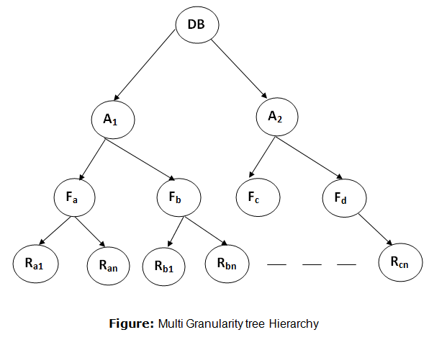

Slide 36
Intention Mode Lock
Intention-shared (IS): It contains explicit locking at a lower level of the tree but only with shared locks.
Intention-Exclusive (IX): It contains explicit locking at a lower level with exclusive or shared locks.
Shared & Intention-Exclusive (SIX): In this lock, the node is locked in shared mode, and some node is locked in exclusive mode by the same transaction.

Slide 37
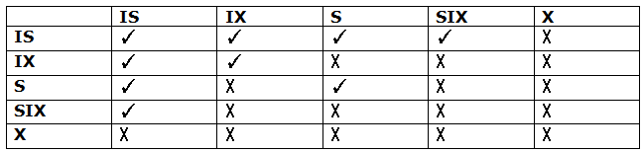
Compatibility Matrix with Intention Lock Modes:
The below table describes the compatibility matrix for these lock modes:

